Slide 1
Static Characteristics of Measurement System Elements
Sensors & Actuators – Joel von Rotz

Slide 2
Contents
Calibration
non-linearity
General model of elements
error of a measuring system of ideal elements
error reduction technique
Accuracy
Precision
and statistical tool.

Slide 3
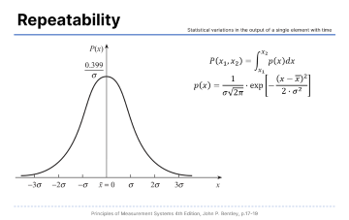
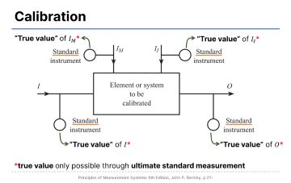
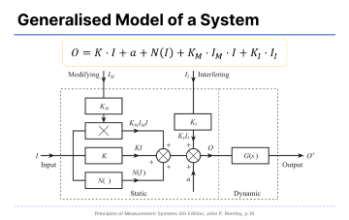
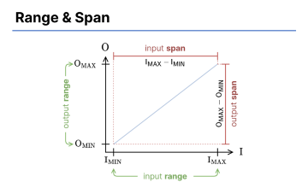

Overview

Slide 4
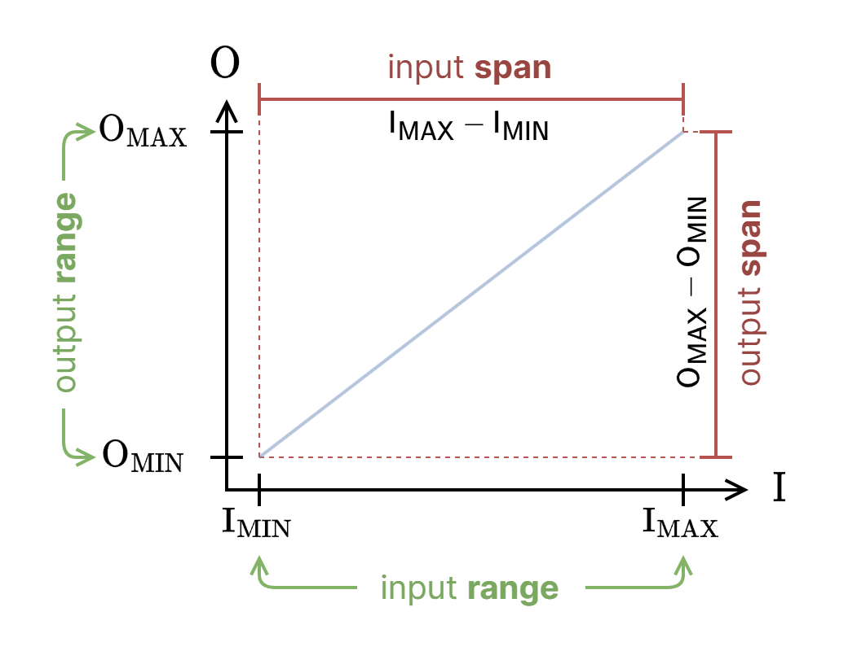
Range & Span

Slide 5
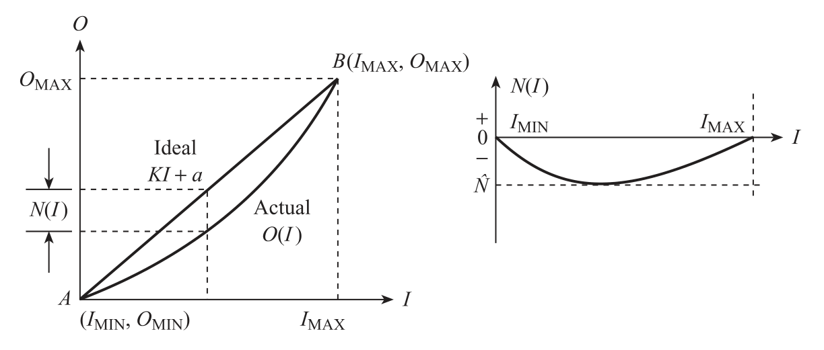


Ideal Straight Line & Non-Linearity
$$O=K⋅I+a+N\left(I\right)$$
$$O_{IDEAL}$$

Slide 6
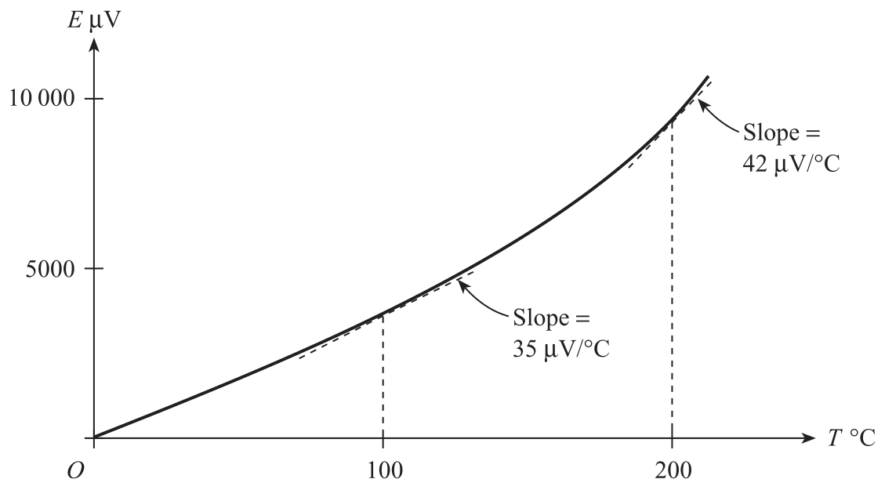
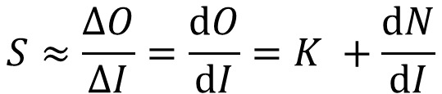
Sensitivity
$$S≈\frac{ΔO}{ΔI}=\frac{dO}{dI}=K +\frac{dN}{dI}$$
For a non-linear element

Slide 7
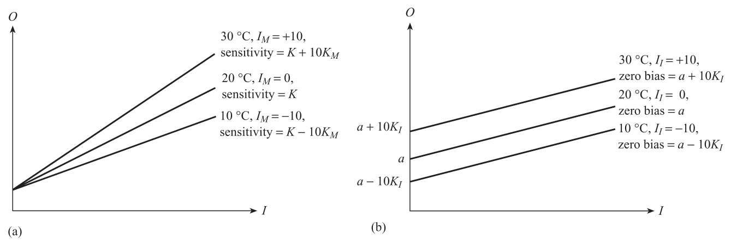
Environmental Effects
Modifying Effect
Interfering Effect
$$O=K⋅I+a+N\left(I\right)+K_{M}⋅I_{M}⋅I+K_{I}⋅I_{I}$$

Slide 8
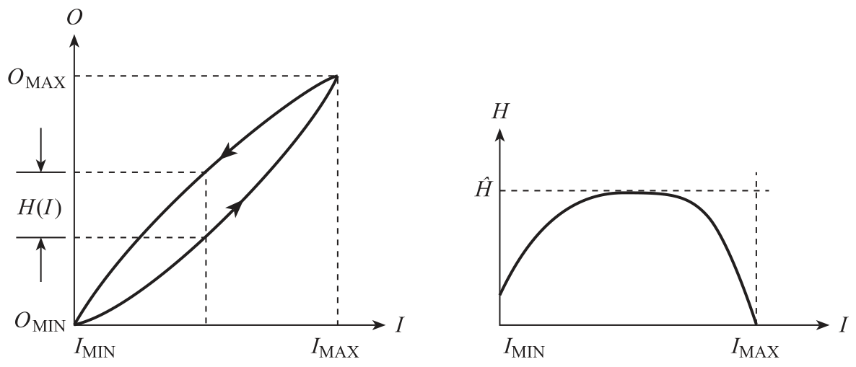

Hysteresis
$$H(I)=O{\left(I\right)}_{I↓}−O{\left(I\right)}_{I↑}$$

Slide 9
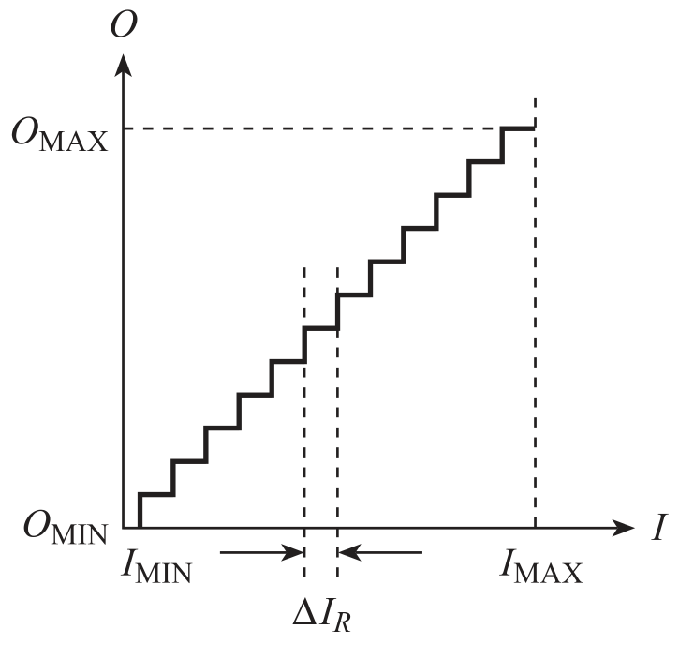
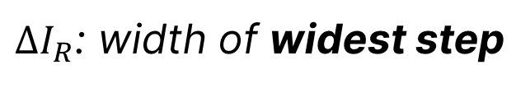
Resolution
$ΔI_{R}$: width of widest step

Slide 10
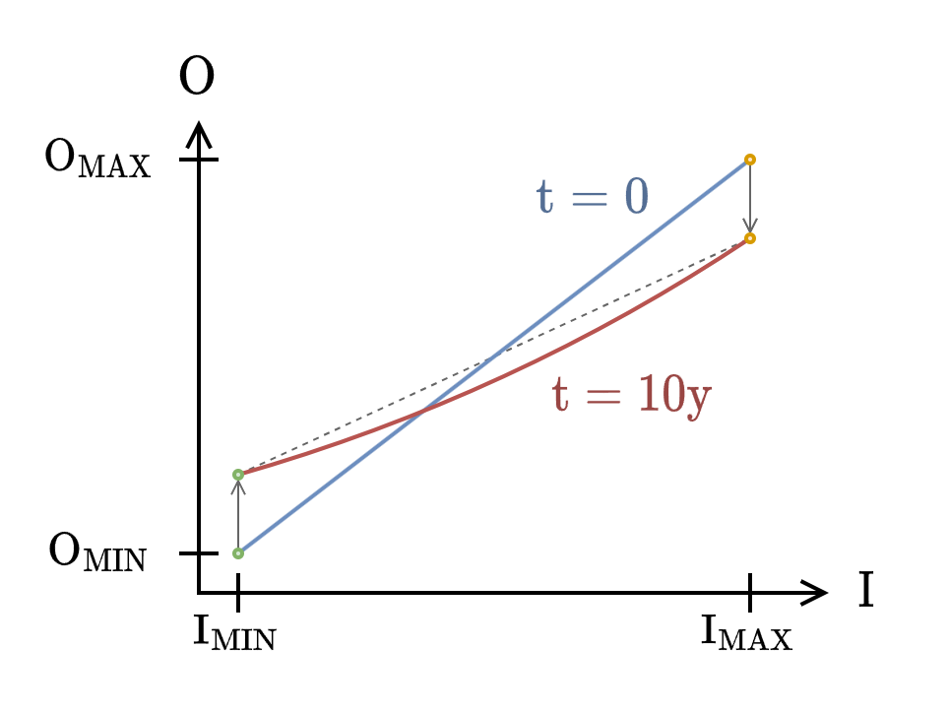
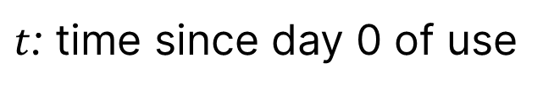
Wear & Aging
$t$: time since day 0 of use

Slide 11
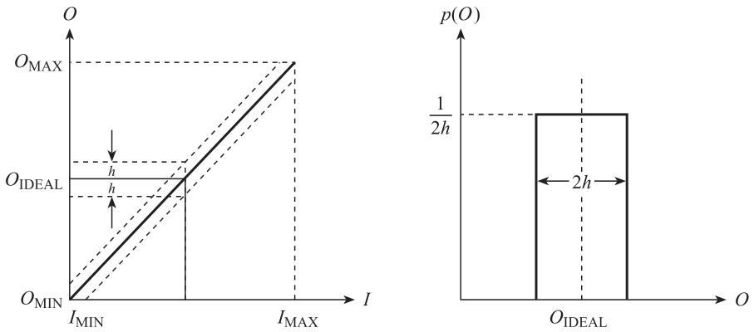
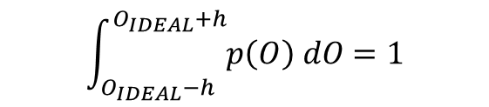
Error Bands
$$\int_{O_{IDEAL}−h}^{O_{IDEAL}+h}{p\left(O\right) dO}=1$$
Notes:
Non-linearity, hysteresis and resolution effects in many modern sensors and transducers are so small that it is difficult and not worthwhile to exactly quantify each individual effect.

Slide 12
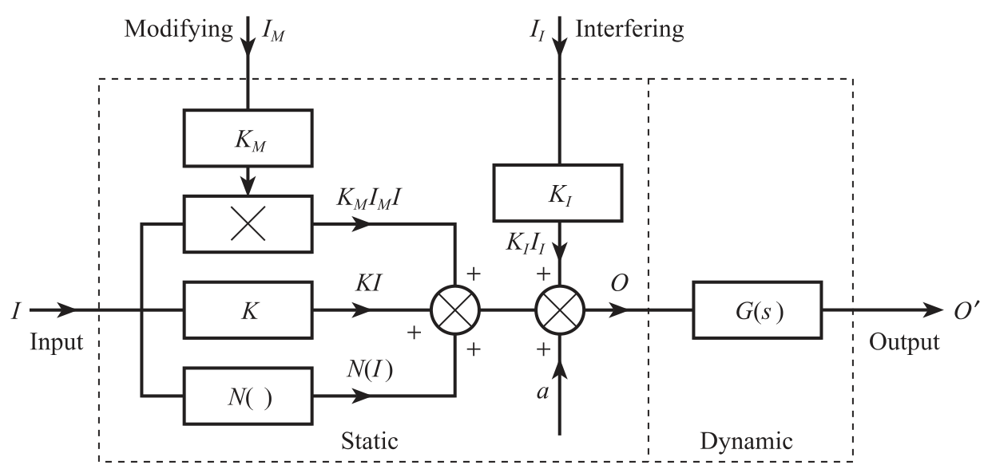
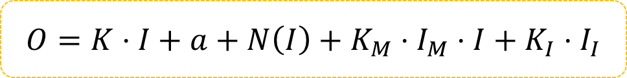
Generalised Model of a System
$$O=K⋅I+a+N\left(I\right)+K_{M}⋅I_{M}⋅I+K_{I}⋅I_{I}$$
Notes:
Non-linearity, hysteresis and resolution effects in many modern sensors and transducers are so small that it is difficult and not worthwhile to exactly quantify each individual effect.

Slide 13
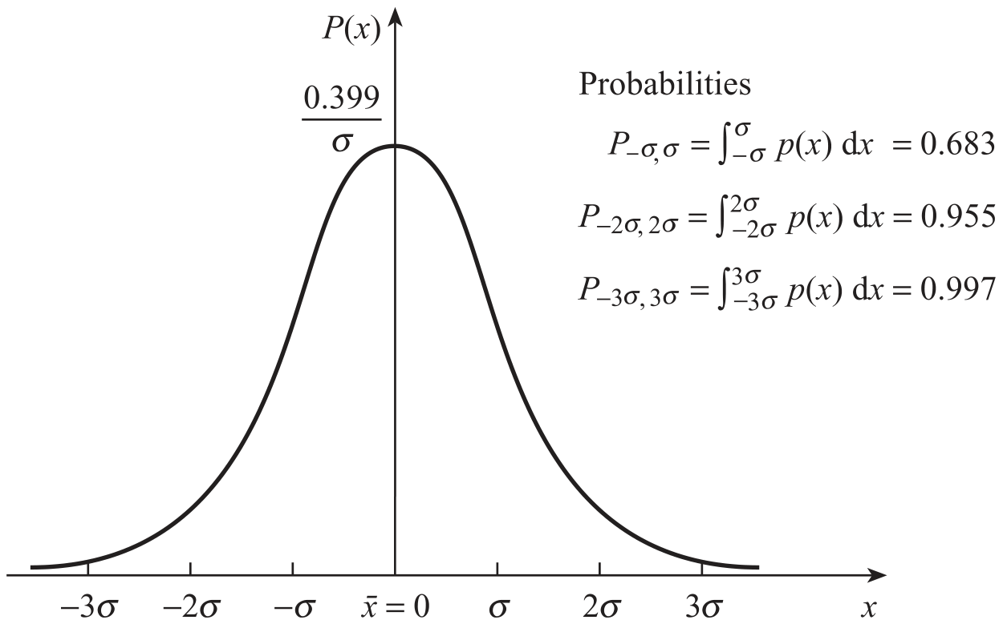

Repeatability
Statistical variations in the output of a single element with time
$$P\left(x_{1},x_{2}\right)=\int_{x_{1}}^{x_{2}}{p\left(x\right)dx}$$
$$p\left(x\right)=\frac{1}{σ\sqrt{2π}}⋅\exp\left[−\frac{{\left(x−\overline{x}\right)}^{2}}{2⋅σ^{2}}\right]$$
Notes:
Repeatability is the process of applying a constant input and observing the output value. Ideally, the output value is constant and the same value all the time.
In reality, this is not the case → external influences.

Slide 14
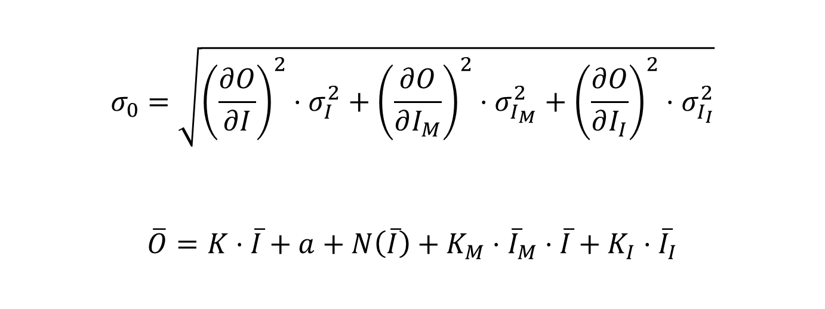
Repeatability
Statistical variations in the output of a single element with time
$$σ_{0}=\sqrt{{\left(\frac{∂O}{∂I}\right)}^{2}⋅σ_{I}^{2}+{\left(\frac{∂O}{∂I_{M}}\right)}^{2}⋅σ_{I_{M}}^{2}+{\left(\frac{∂O}{∂I_{I}}\right)}^{2}⋅σ_{I_{I}}^{2}}$$
$$\overline{O}=K⋅\overline{I}+a+N\left(\overline{I}\right)+K_{M}⋅{\overline{I}}_{M}⋅\overline{I}+K_{I}⋅{\overline{I}}_{I}$$
Notes:
Using the standard deviation of an element, the repeatability can viewed. The higher the deviation, the less repeatable it is.

Slide 15
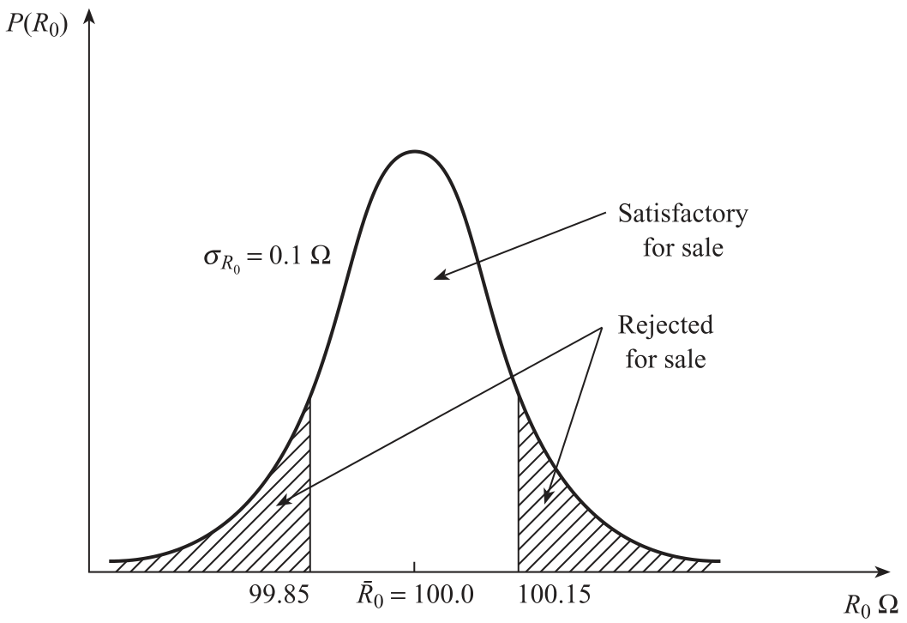
Tolerance
Statistical variations in the output of a single element with time
Notes:
$R_{0}$: the desired/quoted value (in this case resistance)
Tolerance is used when binning products/components, such as MOSFETs. Goal: Bang for the manufacturer’s budget-buck (good enough tolerance that fits the desired manufacturing expenditure).

Slide 16
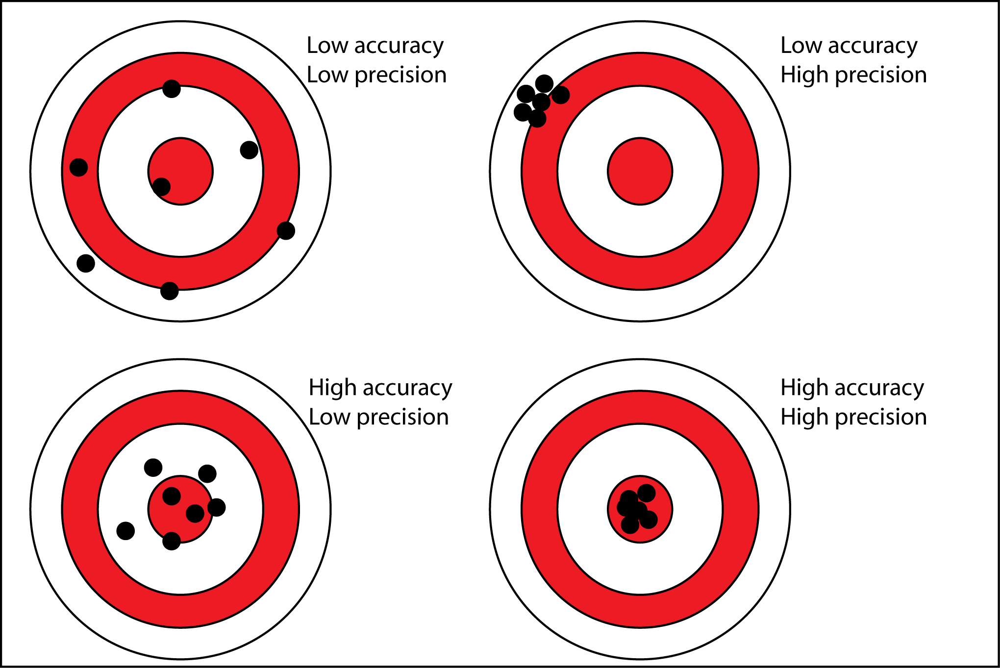
Accuracy & Precision
Notes:
Accuracy defines how close to the truth
Precision defines the standard deviation (how close each measurement is to one another)

Slide 17
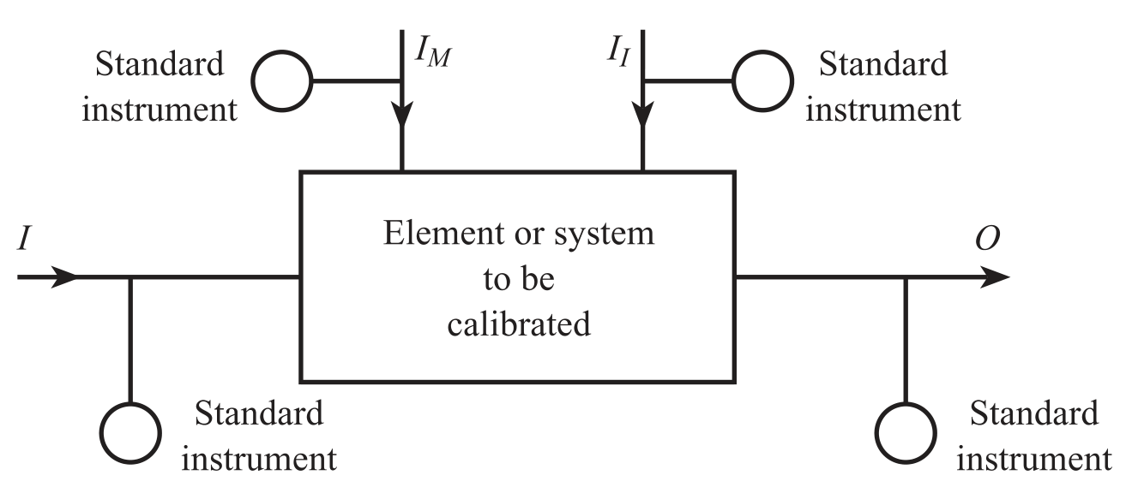
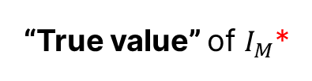
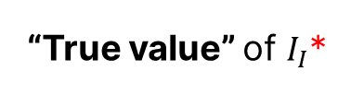
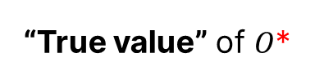
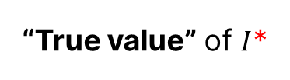
Calibration
“True value” of $I_{M}\text{∗}$
“True value” of $I_{I}$*
“True value” of $I$*
“True value” of $O$*
*true value only possible through ultimate standard measurement
Notes:
What is Calibraiton?
Static characteristics of an element can be found experimentally by measuring the values of input $I$, output $O$ and the environmental inputs $I_{M}$ and $I_{I}$ → $I$ is either at a constant value or changing slowly.
True Values
Standard measurement systems are highly calibrated measurement devices, which allows a system to be calibrated upon the “true value”. The daisy chain the whole calibration goes through introduces accuracy issues

Slide 18
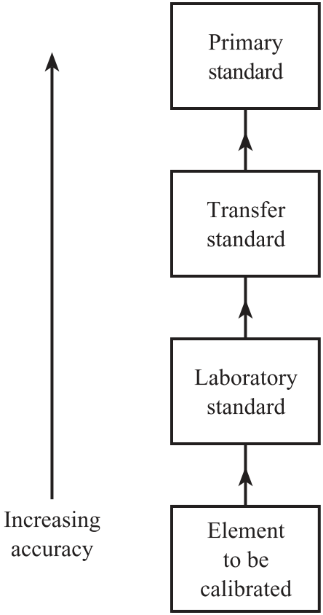
Measurement standard
Ultimate/primary
time, length, mass, current and temperature
Transfer/intermediate
Calibration of standard measurement
Internet Calibration
Calibration against primary or secondary standard at remote location.
Notes:
What is Calibraiton?
Static characteristics of an element can be found experimentally by measuring the values of input $I$, output $O$ and the environmental inputs $I_{M}$ and $I_{I}$ → $I$ is either at a constant value or changing slowly.

Slide 19
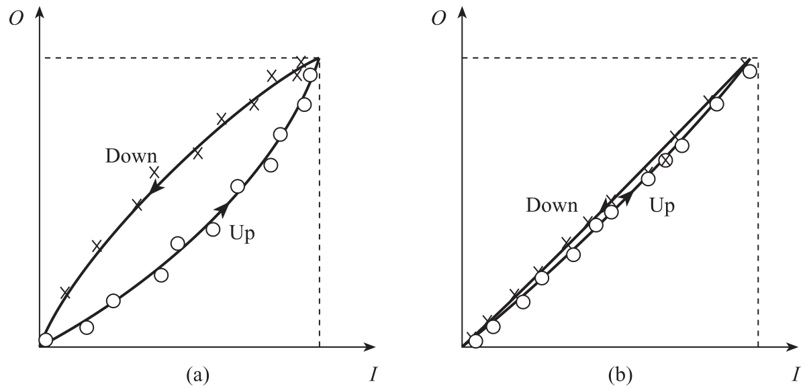
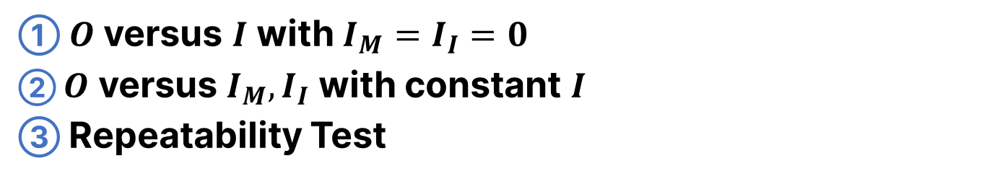
Experimental Measurements
① $O$ versus $I$ with $I_{M}=I_{I}=0$
② $O$ versus $I_{M},I_{I}$ with constant $I$
③ Repeatability Test
Notes:
① $O$ versus $I$ with $I_{M}=I_{I}=0$ (under ‘standard’ environment)
Hysteresis significant (a)
$$N\left(I\right)=O\left(I\right)−(K⋅I+a)$$
Hysteresis is insignificant (b)
$$N\left(I\right)≈0$$
② $O$ versus $I_{M},I_{I}$ with constant $I$ (under ‘standard’ environment)
Determining $K_{I}$
$I=I_{MIN}$
Change $I_{I}$ by a known range
$ΔI_{I}→ΔO$ → $K_{I}$ can be determined
$$K_{I}=\frac{ΔO}{ΔI_{I}}$$
Determining $K_{M}$
$I=\frac{I_{MAX}−I_{MIN}}{2}$: mid-value of input range
Change $I_{M}$ by a known range
3a. If $O$ changes only modifying (no interference):
$$K_{M}=\frac{ 1}{I}⋅\frac{ΔO}{ΔI_{M}}=\frac{2}{I_{MIN}+I_{MAX}}⋅\frac{ΔO}{ΔI_{M}}$$
3b. If $O$ changes modifying & interference:
$$K_{M}=\frac{2}{I_{MIN}+I_{MAX}}⋅\left[\frac{ΔO}{ΔI_{I,M} }−K_{I}\right]$$
③ Repeatability (under normal environment)
Measure Standard Deviation $σ$ and compare with old deviation

